Slide 1
Middle East Map
Introduction
Video Link
Notes:
https://www.youtube.com/watch?v=1d--L3rxBu4

Slide 2
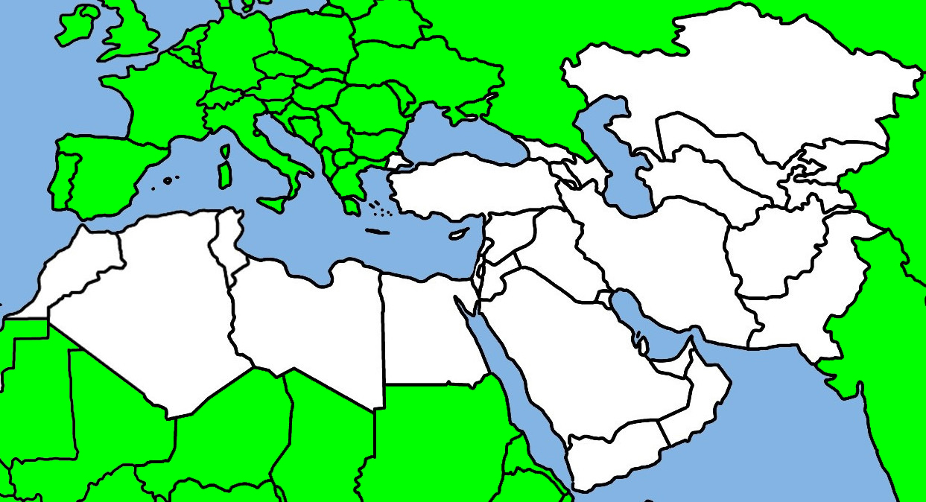
Day 1
India is wearing a dragon backpack. Pakistan is “backpackistan”
Draped over the backpack is an afghan blanket (Afghanistan)
Pair of eyes (i’s), Iraq & Iran
The snail who ran from the boot is Iran
Iraq
Iran
Afghanistan
Pakistan
Notes:
https://www.youtube.com/watch?v=1d--L3rxBu4

Slide 3
Day 1
Practice
Notes:
https://www.youtube.com/watch?v=1d--L3rxBu4

Slide 4
Day 1
Review
India is wearing a dragon backpack.
Draped over the backpack is an afghan blanket
Pair of eyes (i’s)
The snail who ran from the boot
Notes:
https://www.youtube.com/watch?v=1d--L3rxBu4

Slide 5
Day 2
Kazakhstan
Kyrgyzstan
Tajikistan
Uzbekistan
THINK- Turkey Men Ooze Tragic Kurds
(Add stans on the end)
Turkey men=Turkmenistan, Ooze= Uzbekistan,
Tragic= Tajikistan, Kurds=Kyrgyzstan
Turkmenistan
Notes:
https://www.youtube.com/watch?v=1d--L3rxBu4

Slide 6
Day 2 Practice
Notes:
https://www.youtube.com/watch?v=1d--L3rxBu4

Slide 7
Day 2 Review
THINK- Turkey Men Ooze Tragic Kurds
(Add stans on the end)
Notes:
https://www.youtube.com/watch?v=1d--L3rxBu4

Slide 8
Day 3
THINK- Fit Countries
Georgia
Armenia
Azerbaijan
Body by George = Georgia
Arm Mania = Armenia
Abs by Jan = Azerbaijan
Fit people eat Turkey sausages
Fit people eat cereal for breakfast
Turkey
Syria
Notes:
https://www.youtube.com/watch?v=1d--L3rxBu4

Slide 9
Day 3 Practice
THINK- Fit Countries
Notes:
https://www.youtube.com/watch?v=1d--L3rxBu4

Slide 10
Day 3 Review
THINK- Fit Countries
Body by George
Arm Mania
Abs by Jan
Fit people eat Turkey sausages
Fit people eat cereal for breakfast
Notes:
https://www.youtube.com/watch?v=1d--L3rxBu4

Slide 11
Day 4
Jordan wears a holstered gun
Sharp knife is Israel- yes it’s real
Rub lemon on the knife to keep it real- Lebanon
West Bank
Lebanon
Israel
Jordan
Gaza
Notes:
https://www.youtube.com/watch?v=1d--L3rxBu4

Slide 12
Day 4
Practice
Notes:
https://www.youtube.com/watch?v=1d--L3rxBu4

Slide 13
Day 4
Review
A holstered gun
Sharp knife -yes it’s real
Rub lemon on the knife to keep it real-
Notes:
https://www.youtube.com/watch?v=1d--L3rxBu4

Slide 14
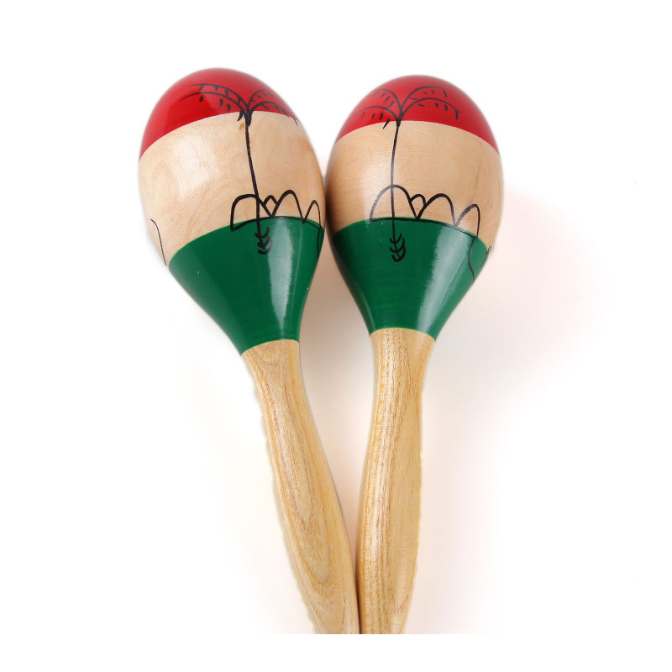
Day 5
Morocco is shaped like a maraca
Remember that the tuna (Tunisia) is jumping away from the algae (Algiers) towards liberty (Libya)
Tunisia
Morocco
Algiers
Libya
Egypt
To remember the countries in North Africa , think MALE (first letter of countries)
Notes:
https://www.youtube.com/watch?v=1d--L3rxBu4

Slide 15
Day 5 Practice
Notes:
https://www.youtube.com/watch?v=1d--L3rxBu4

Slide 16
Day 5 Review
Remember that the tuna is jumping away from the algae towards liberty
To remember the countries in North Africa , think MALE (first letter of countries)
Notes:
https://www.youtube.com/watch?v=1d--L3rxBu4

Slide 17
Day 6
*Combat boot is Saudi Arabia
*Sole of the boot is yo- Yemen & Oman
*Your friend say ”Ya man!” and then after bad news says “Oh man!”
Oman
Saudi Arabia
Yemen
Notes:
https://www.youtube.com/watch?v=1d--L3rxBu4

Slide 18
Day 6
Practice
Notes:
https://www.youtube.com/watch?v=1d--L3rxBu4

Slide 19
Day 6
Review
*Combat boot
*Sole of the boot is yo
*Your friend say ”Ya man!” and then after bad news says “Oh man!”
Notes:
https://www.youtube.com/watch?v=1d--L3rxBu4

Slide 20
Day 7
THINK- I can’t wait for it to rain Q-tips- Yeah!
Can’t wait (Kuwait)- to rain (Bahrain)- Q-tips (Oatar)- Yeah (UAE)
Kuwait
Bahrain
Qatar
UAE
Notes:
https://www.youtube.com/watch?v=1d--L3rxBu4

Slide 21
Day 7 Practice
Notes:
https://www.youtube.com/watch?v=1d--L3rxBu4

Slide 22
Day 7 Review
THINK- I can’t wait for it to rain Q-tips- Yeah!
Notes:
https://www.youtube.com/watch?v=1d--L3rxBu4

Slide 23
Day 8- Cities (Honors)
Amman- (Jordan is a man)
Ankara- (Carve a turkey)
Baghdad- (dad has baggie eyes)
Cairo- Egypt
Damascus- (eat some damn cereal)
Dubai- UAE
Islamabad- (the dragon says Islam is not bad)
Istanbul- (eat turkey & bull sausages)
Jerusalem- Israel
Kabul- Afghanistan
Mecca- Saudi Arabia
Teheran- (the snail ran- Iran)

