Slide 1
Territorial Utah and The Utah War
Chapter 9

Slide 2
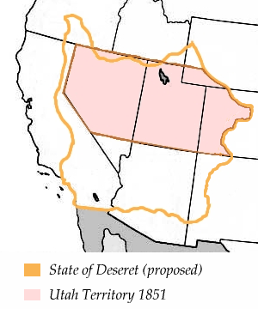
Proposed State of Deseret
Soon after arriving in Utah, Brigham Young and other leaders wrote a constitution
Wanted the State of Deseret
“Deseret” meant honeybee – industry, hard work
Petition turned down by federal government

Slide 3
Compromise of 1850
Issue of slavery divided North and South
Evenly split in Senate – half of states were free and half were slave
California asked to join as a free state
Would tip the balance
Henry Clay (Great Compromiser) said to allow CA in, and create 2 territories – New Mexico and Utah – which could decide for themselves if they were free or slave territories. (The compromise also included the fugitive slave act)

Slide 4
Utah becomes a territory
Voted to allow slavery
Run by federal government
President Fillmore appoints Brigham Young governor
3 judges appointed from the East
This makes people upset

Slide 5
The Utah War
The 3 Judges return to D.C. and tell the president…
Mormons are killing non-Mormons
Mormons are destroying legal records
Mormons treat non-Mormons unfairly in court
President Buchanan appointed a new governor and sent Johnston’s army to escort him to the Utah Territory
Brigham Young assumes it is an attack, so he calls out the militia

Slide 6
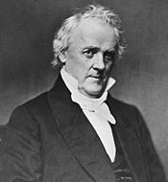
Events leading to war…
Ooops!
This became known as Buchanan’s Blunder because he didn’t investigate the rumors before sending troops to Utah.
The army was led by Colonel Johnston and a new governor traveled with the Army to replace Brigham Young.

Slide 7
The Utah War
Mormon Militia prepare for Johnston’s army by…
Destroying supply wagons, animal feed, and driving off animals
Also burned Fort Bridger and Fort Supply
Army forced to stop in Wyoming due to snow and lack of supplies.
Mormons abandoned Salt Lake City and other northern communities
Prepared their homes, food, and fields to be torched
Buried foundations of Salt Lake Temple

Slide 8
Notes:
The Church of Jesus Christ of Latter-Day Saints, commonly referred to as the Mormon Church, was organized in the eastern United States in 1830. Mormons gathered in communities that faced increasing opposition as their numbers grew. Mormons fled what they and most historians term persecution in New York and Ohio and eventually built communities around Independence, Missouri and in Nauvoo, Illinois. Joseph Smith, the founder of the LDS Church, was killed, and as persecution increased, Brigham Young, the new leader of the church, determined to lead a Mormon migration into the West. It should be noted that a handful of historians claim that Mormons overstated the “persecution” they faced. These historians highlight, instead, the actions Mormons took that provoked their neighbors. In 1847, Mormon pioneers began to settle in the Great Basin, in territory that belonged to Mexico. The following year the region was annexed into the United States through the Treaty of Guadalupe Hidalgo. In 1850, the United States officially recognized Utah as a territory and federal officials were sent to administer in the region. Brigham Young was appointed territorial governor.

Slide 9
Notes:
Non-Mormon federal officials in Utah soon became frustrated by ongoing conflicts with Mormon leaders, and they accused Mormons of un-American practices. Because Brigham Young served as president of the LDS church and territorial governor they lamented the lack of separation between church and state. Converts to the Mormon Church from Scandinavia and the British Isles migrated to Utah in large numbers, raising further questions about Mormons’ loyalty to the United States. The practice of polygamy, common among Mormon men in pioneer Utah, brought further condemnation from easterners and contributed to widespread anti-Mormon sentiment. Utah’s application for statehood in 1856 was denied.

Slide 10
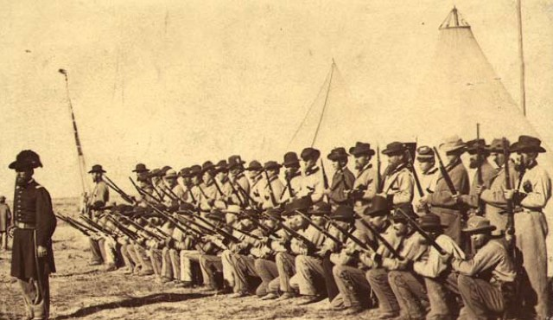
Notes:
Instead, in 1857 President James Buchanan sent an army of about 2,500 soldiers to quell what he called the “Mormon Rebellion” in Utah. They brought with them Alfred Cumming to replace Brigham Young as territorial governor. Officials of the United States did not communicate to Mormon leaders the purpose of the approaching army. As the troops made the long journey across the American Great Plains, Mormons in Utah prepared for what they considered an armed invasion. Brigham Young ordered that all goods be stockpiled. The approaching US army led many Mormons to fear that the persecution they had faced in the East would now be repeated in Utah. Determined to defend themselves against what they perceived was repeated oppression, Mormon leaders sent their own militia to slow the troops, destroy their supplies, burn the prairie grass needed for army stock, and do all they could to harass the troops. Some Mormon leaders, including many in southern Utah preached fiery sermons calling on Mormon men to fight to defend their faith and families.

Slide 11
Notes:
That same year many emigrant groups crossed the Great Plains driving cattle and hauling belongings toward California. Included among the many companies were the Baker, Dunlap, Fancher, Miller, Tackitt and other families from Arkansas. Following the Southern Road to California, these emigrants entered the Salt Lake Valley in early August, just as anxieties were rising among Mormons about the approaching United States army. Tensions developed between Mormons and emigrants passing through Salt Lake City and other Mormon communities, with both sides contributing to the animosity. Some historians claim that the Mormons were solely to blame for the growing animosity and that evidence of the emigrants contributing to the conflict were merely rumors started by Mormons after the massacre to justify it. Most historians today believe that both Mormons and emigrants expressed harsh words as they came into conflict over the limited grasslands and as Mormons, following their leaders’ orders to stockpile grain, withheld much needed supplies from the emigrants. The largest conflict occurred in Cedar City on September 3, 1857.

Slide 12
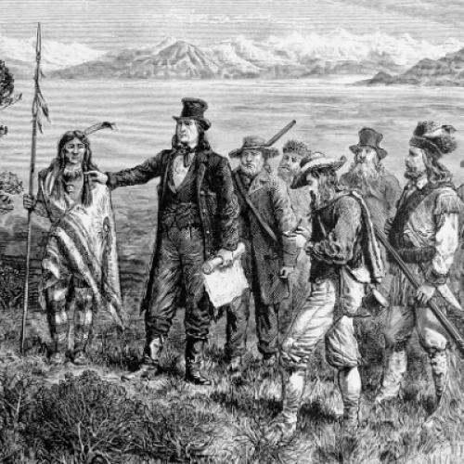
Notes:
There were also many Indian nations in Utah during the time. The Mormons wanted the Indians to help them fight against the soldiers. Because the Mormons appeared friendly to Indians, emigrants didn’t trust the Mormons. Still, Indians sometimes felt like the Mormons were not treating them the right way. As part of the war, Mormon leaders asked the Indians to chase the cattle away from emigrant groups and the army. As the army approached, Brigham Young announced that the Mormons would no long discourage Native Americans from raiding emigrant companies as they had previously done. Again some historians claim, and rumors at the time were widely circulated, that the Mormons had been colluding with American Indians to attack emigrant groups after the Mormon’s first arrival in the Great Basin. However, the majority of historians understand the changing nature of Mormon/Indian/emigrant relations and note the significant change in Mormon policies when the American troops were approaching in 1857.

Slide 13
Notes:
On September 11, 1857, at a place called Mountain Meadows, Mormon militiamen and Paiute Indians massacred the Baker, Dunlap, Fancher, Miller, Tackitt and other families from Arkansas, along with many others who had joined their wagon train. After a few days of fighting between Paiutes, joined by a handful of Mormons, and the emigrant party, Mormon militiamen lured the emigrants from their defensive positions under a flag of truce and together with Paiutes who had been waiting to ambush them began the slaughter. About 120 people, including many women and children, were killed. A few young children who were too young to tell what had happened were spared and were taken in by Mormon families. After the massacre those who were involved took the emigrants’ belongings and tried to hide what they had done. Mormons tried to blame the entire attack on the Paiutes, which wasn’t true.

Slide 14
Notes:
Without knowing what had happened to the emigrant wagon train, the U.S. army got stuck near Fort Bridger, (in modern day Wyoming) during the winter. This gave the Mormon leaders and U.S. leaders a chance to communicate and to find some solutions to their disagreements. Their meetings ended what is now called the “Utah War” before any real fighting happened between the Mormon militia and the army. Alfred Cumming replaced Brigham Young as territorial governor and a U.S. army was stationed at Camp Floyd southwest of the Salt Lake Valley.

Slide 15
Notes:
It didn’t take long before outsiders realized that something terrible had happened to the emigrants. A wagon train passing shortly behind them saw the bodies of massacre victims and reported it to California newspapers. As news of a massacre spread, various rumors circulated about who was involved. It didn’t take long before the blame was laid on the Mormons of southern Utah. Rumors also spread about the involvement of Brigham Young and other high-ranking leaders of the Mormon church. Eventually, investigators accused John D. Lee of orchestrating the Native American attack as well as organizing the activities of the Mormon militia that carried out the massacre. He was later convicted of the crimes. He was executed 20 years after the Mountain Meadows Massacre at the site where the massacre had occurred. Many federal officials tried to find evidence of a direct link between Brigham Young and the attack but they were unsuccessful. (Some historians think that Brigham Young had no direct connection. Other historians think that Mormons destroyed any evidence linking Young with the attack.) Eight others, most of them local leaders of the Mormon church and the militia in southern Utah were charged with crimes. Some of them lived out their lives as fugitives from the law. The LDS church disciplined some of the people involved in the massacre and others left the church. Some of the Paiutes who were involved were shunned by others. Only Lee was tried and executed.

Slide 16
Interpretations
What are the theories

Slide 17
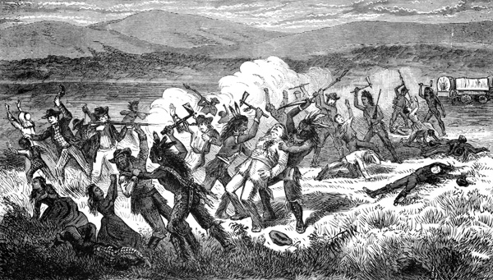
Missouri Wildcat Theory
Notes:
A group of trouble makers who called themselves the “Missouri Wildcats” joined the peaceful Fancher-Baker party as they crossed through Utah. The Missouri Wildcats became angry when the Mormons would not sell or trade the supplies they needed. They trampled Mormons’ gardens, broke down fences, hurt Mormon women, killed their chickens, and put poison in their water. The Missouri Wildcats made fun of the Mormons, threatened them, and said they helped kill the Mormon prophet, Joseph Smith. They left behind a poisoned ox, hoping that Native Americans would eat it and die. They said they would come back from California with an army and help in the war against the Mormons. When some Paiutes died after eating the ox, the other Paiutes decided to attack the emigrants. They asked the Mormons to help them. The Mormons had little choice because they needed the Paiutes to help them in the fight against the US Army. They were also afraid of the emigrants’ threats to help the army. The Mormon militia helped the Paiutes by tricking the emigrants and leading them out of their protected wagons. Mormon men killed the emigrant men and Paiute warriors killed the women and children. (This interpretation was common within the LDS community during the 20th century even after Juanita Brooks challenged it with her book, Mountain Meadows Massacre. During the 19th century this general story was common within the LDS community except that the blame for the massacre fell upon the Paiute Indians and local Mormon militia leader John D. Lee. This version of the massacre is still popular within LDS communities though LDS historians, such as Richard Turley, discount much of this interpretation). (Missouri Wildcat Theory)

Slide 18
Brigham Young Theory
Notes:
Mormons heard that the US army was coming about the same time that they heard that their beloved apostle Parley P. Pratt had been murdered in Arkansas. When the emigrant party entered the Salt Lake Valley, Brigham Young found out they were from Arkansas and he was determined to avenge the death of Pratt. He sent a Mormon apostle, George A. Smith, to southern Utah faster than the emigrants. George A. Smith told the local leaders to kill the entire wagon train when they were in a quiet area where nobody would find out. A couple of days later Brigham Young decided that he had made a mistake. He sent another messenger with a note that told the Mormons to let the emigrants pass. But before the message arrived, Mormon leaders convinced the Paiutes to attack the emigrants. After 5 days of fighting, the Mormons tricked the emigrants into coming out of their protected places. Then the Mormon militia killed the emigrants with a few Paiute Indians joining in the massacre. (This interpretation was promoted by disgruntled Mormon, Will Bagley in his book Blood of the Prophets. Many book reviews are critical of Will Bagley’s selective use of evidence, his tampering with key pieces of evidence, and his anti-Mormon bias.) (Brigham Young Theory)

Slide 19
Anger and Fear Theory
Notes:
Arguing between the emigrants and Mormon settlers got worse as the emigrants traveled south toward Cedar City. Emigrants were angry that the Mormons would not sell them supplies. Some members of the wagon train told the Mormons they would help the US Army that was coming. After the emigrants left Cedar City some local Mormon leaders wanted to follow them, hurt them, and scatter their cattle. Other Mormons disagreed but were afraid to confront their local church leaders or to disobey orders from militia leaders. Isaac Haight, a local Mormon leader, asked John D Lee, a friend of the Paiute Indians, to lead an Indian raid on the emigrants. For five days, the Indians and John D. Lee, who was disguised as an Indian, attacked the emigrants who had circled their wagons in defense. While the fighting was going on the Mormons sent a messenger to Brigham Young to see what they should do. Brigham Young was 250 miles away. Two men from the emigrants who were looking for stray cattle and collecting pine tar to repair wagons remained unaware of the attack. While in Cedar City, members of the Mormon militia killed one of the men and tried to kill the other but he escaped and rode to the circled wagons. Now the emigrants knew that some of the Mormons were involved. Isaac Haight, John D. Lee, and other Mormon leaders decided that the entire party must die because they were afraid that the emigrants would tell other people that the Mormons had planned and been involved in the Indian attack. John D. Lee tricked the desperate emigrants into leaving their wagons and told them the Mormon militia would help them get back to Cedar City safely. But instead the members of the militia began killing them. Indians who were hiding helped the Mormons. Only 17 children who were too young to tell about what had happened were left alive. After the attack the messenger that had been sent to get Brigham Young’s advice returned with the message from Brigham Young to let the emigrants pass. (This interpretation comes from the book Massacre at Mountain Meadows, co-authored by three LDS historians.) (Anger and Fear Theory)

Slide 20
Rich Wagon Train Theory
Notes:
That emigrant party was one of the richest groups to pass through Utah in 1857. They had a large herd of cattle and other animals and one horse that was worth thousands of dollars. Mormons thought that the cattle, weapons, and other supplies of the emigrants could help them in their war with the US Army. They could share the things that they took with the Paiutes, which would win the favor of the Paiutes and help make sure the Paiutes would help fight the US Army. The massacre was planned by Mormons and carried out by both Mormons and Paiutes in order to take the emigrants’ property and help them in the war against the United States. (This interpretation is a synthesis of ideas promoted in the books Blood of the Prophets and Massacre at Mountain Meadows and several non-Mormon 19th century sources.) (Rich Wagon Train Theory)

Slide 21
What was the cause of the Mountain Meadows Massacre?

Slide 22
document | source, audience, purpose | strengths of the evidence | weaknesses of the evidence | How does this evidence support any of the theories | How does this evidence weaken any of the theories
Doc 1 | Sarah Baker Mitchell, surviving child, to a MA. newspaper, tell her story before she died. | Eye witness non-Mormon | 83 years later 22 months old at the time.

Slide 23
document | source, audience, purpose | strengths of the evidence | weaknesses of the evidence | How does this evidence support any of the theories | How does this evidence weaken any of the theories
Doc 1 | Sarah Baker Mitchell, surviving child, to a Cal. newspaper, tell her story before she died. | Eye witness non-Mormon Not bitter (less biased) | 83 years later 22 months old at the time. Second hand on some things | Rich wagon train theory | It doesn’t

Slide 24
document | source, audience, purpose | strengths of the evidence | weaknesses of the evidence | How does this evidence support any of the theories | How does this evidence weaken any of the theories
Doc 1 | LDS historians Turley, Walker, and Leonard in 2008. Give the modern Mormon perspective | Trained historians with access to more evidence. Say Mormons did “terrible things” (less biased) | LDS employees may not criticize LDS leaders. Not eye-witnesses. | Anger and Fear Theory, Rich Wagon Train Theory | It doesn’t

Slide 25
Review of Mountain Meadows Massacre
1857: Mormons are preparing for Johnston’s army
120 Arkansas and Missouri immigrants (the Fancher party) cross southern Utah on their way to California
Mormons will not trade with the Fancher party
A Mormon leader had just been killed in Arkansas, and these immigrants started bragging about the murder
A rumor that the immigrants had poisoned a well, killing Paiutes and their animals
Paiutes attacked but were driven back

Slide 26
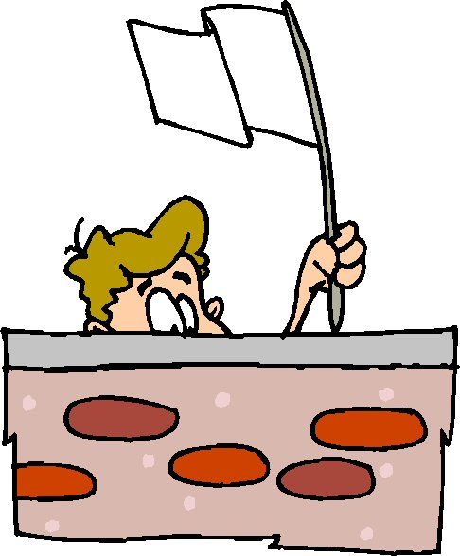
Review of Mountain Meadows
Isaac Haight sent a rider to SLC to ask Young for advice
Haight and John D. Lee decided to ally with the Paiutes and attack the immigrants
Paiutes encircled the immigrants, and then Lee approached with a white flag of truce
Mormons agreed to give the immigrants safe passage if they put their weapons away
Sent women and children ahead of the men

Slide 27
Review of Mountain Meadows
Had one soldier next to each male immigrant
“Halt, each man do your duty.”
Turned and shot the immigrant, or stepped back and allowed the Paiutes to do it
Killed all of the men, then went and killed all of the women, and any children old enough to report
Only 18 small children were left alive

Slide 28
Camp Floyd
Army entered in spring of 1858 to find SLC deserted.
Set up a military base in the Oquirrh Mountains; Camp Floyd
Good things that Camp Floyd or the army brought to Utah
Strengthened Utah’s economy, provided jobs, soldiers had to buy supplies from Utahans
Bad things that Camp Floyd or the army brought to Utah
Brought the “Wild West” to Utah… gamblers, saloons, prostitution, cattle rustlers, etc.
Had to have a gun or didn’t feel safe
Johnston’s army called back when Civil War started in 1860
War ended without a shot fired
Colonel Patrick Connor replaces Johnston’s army

Slide 29
The New Governor
Alfred Cumming, the new governor, tried to be fair to all people
Won more friends than enemies
Abraham Lincoln sent Colonel Patrick Connor with a group of men to “protect overland mail route”
Probably to keep an eye on the Mormons
Cold War

Slide 31
Why was it so hard for Utah to become a state?
Polygamy
No Political Parties
Too Large of a land mass for the Population

Slide 32
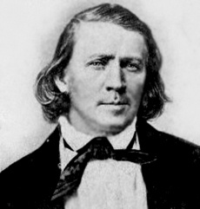
Polygamy
Did you know that Brigham Young had 56 wives… many were widows that were older than him that he cared for. He had a total of 57 children with 16 of his wives.

Slide 33
Issues with Polygamy
People in the East believed that if women in Utah could vote, they would end polygamy
When they didn’t, the federal government took away the right to vote as punishment
Republican Party’s platform was to eliminate the “twins of barbarism – slavery and polygamy”
Passed laws making polygamy illegal – could be arrested for 5 years and fined $500 (equal to $11,000 today).

Slide 34
Reynolds v. United States
Mormons believed polygamy was protected under the 1st amendment, and that the Supreme Court would agree
Took the case to the Supreme Court, but the Court decided that beliefs not practices were protected
Polygamy declared illegal
“Can a man excuse his practices…because of his beliefs? To permit this would be to…permit every citizen to become a law unto himself.” (Chief Justice Waite)

Slide 35
Consequences
Cohab hunting: informers were paid $20 for each polygamist they found ($450 of today’s money)
Became a favorite pastime and source of income for Utahans
Many Mormon men chose to go to prison rather than give up polygamy
Many polygamists went into hiding. Others went to Mexico or Canada. Others were called on missions to foreign countries.
John Taylor became the leader in 1877, and died while in hiding in 1887

Slide 36
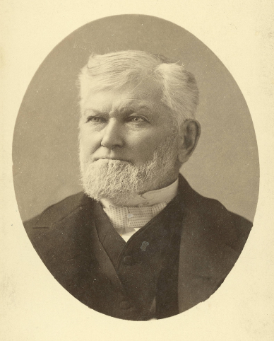
The Manifesto
Impossible for Mormons to live polygamy
President Wilford Woodruff (4th leader) issued the Manifesto in 1890, ending polygamy
“Inasmuch as laws have been enacted by Congress forbidding plural marriages, which laws have been pronounced constitutional by the court of last resort, I hereby declare my intention to submit to those laws, and to use my influence with the members of the Church over which I preside to have them do likewise…I publicly declare that my advice to the Latter-day Saints is to refrain from contracting any marriages forbidden by the law of the land.” (Woodruff)

